Slide 1
Secure Data Hiding in Image Using Steganography
CAPSTONE PROJECT
Presented By: Varshini M
Student Name : Varshini M
College Name Sri Krishna Adithya College of Arts and Science
Department : BSc Data science

Slide 2
OUTLINE
Problem Statement
Technology used
Wow factor
End users
Result
Conclusion
Git-hub Link
Future scope

Slide 3
Problem Statement
To Develop a simple steganography program that hides a secret message inside an image by modifying pixel values. The program should allow users to encrypt a message into an image using ASCII values and later decrypt it using a passcode. If the correct passcode is entered, the hidden message is extracted; otherwise, access is denied.

Slide 4
Technology used
Python – Primary programming language for implementation.
OpenCV (cv2) – Used for image processing and pixel manipulation.
ASCII Encoding – Converts characters into numeric values for embedding in the image.
File Handling & OS Module – Manages image reading, writing, and execution.

Slide 5
Wow factors
Steganography Technique – Hides a secret message inside an image without altering its appearance.
Passcode Protection – Ensures only authorized users can decrypt the message.
Pixel-Level Encryption – Embeds data at the RGB pixel level for enhanced security.
Lightweight & Fast – Simple implementation with minimal processing overhead.

Slide 6
End users
This program is useful for cybersecurity professionals, privacy enthusiasts, and students learning steganography. It can also benefit journalists, whistleblowers, and intelligence agencies for secure communication. Additionally, it serves as an educational tool for those exploring image processing and encryption techniques.

Slide 7
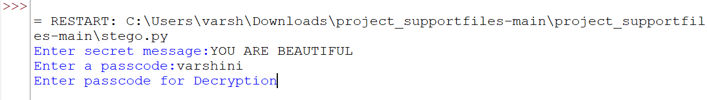
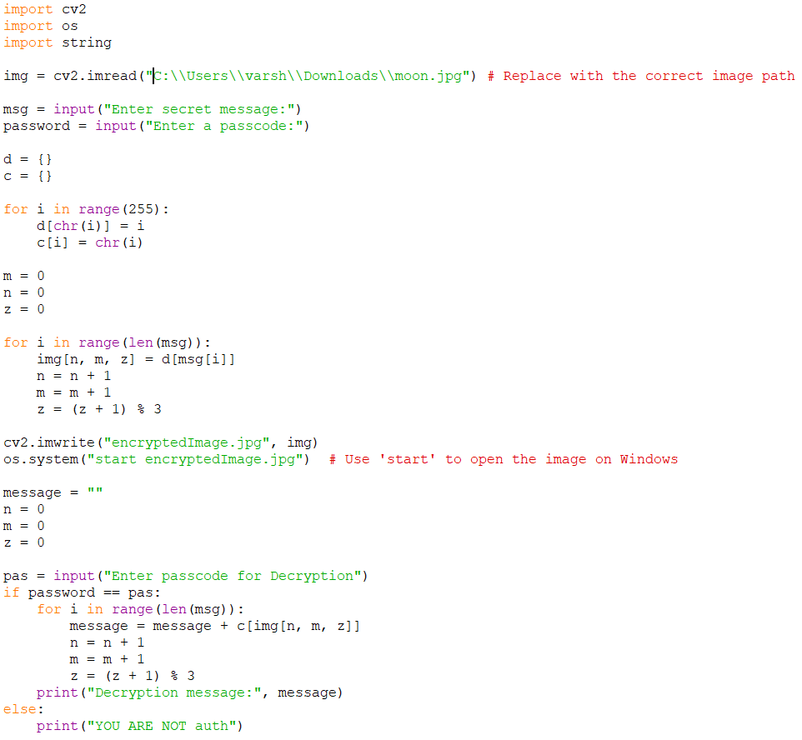

Results
Encrypted Image

Slide 8
Conclusion
This steganography-based program provides a simple yet effective method for securely embedding and retrieving secret messages within images. By leveraging pixel-level encryption and passcode protection, it ensures that only authorized users can access the hidden information. The implementation is lightweight, fast, and easy to use, making it a valuable tool for privacy-conscious users and cybersecurity learners.

Slide 9
GitHub Link
https://github.com/Varshini06-ctrl/Stegnography.git

Slide 10
Future scope
The program can be enhanced by implementing stronger encryption algorithms (e.g., AES) for added security. It could support different image formats and higher data capacities while maintaining image quality. Adding AI-based anomaly detection can help detect hidden messages in images. Additionally, integrating mobile and web applications would make the tool more accessible for real-world secure communication.

Slide 11
THANK YOU

